Slide 1



Please help us!
Thank our Sponsors:

Slide 2

Map Reduce

Slide 3
Please Be Courteous!

Slide 4









About Me… Kevin Whitson
15+ years software development
10+ years database administration
2.5 years working in Hadoop
LinkedIn: www.kevinwhitson.com
Blog: www.idledeveloper.com

Slide 5

About You…
Who uses Hadoop daily?
Who uses Hadoop weekly?
Who uses Hadoop monthly?
Anyone never use it at all?

Slide 6





About free Hadoop VMs
Hortonworks
VMware, VirtualBox, Sandbox in the cloud
Cloudera
VMware, VirtualBox, Docker, KVM

Slide 7
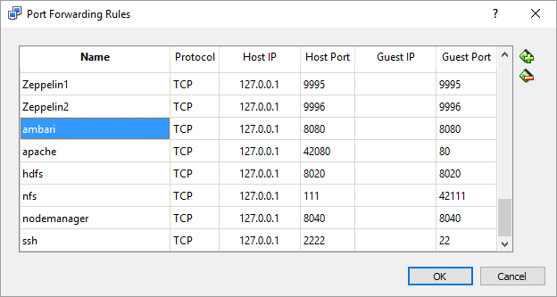
About The Hortonworks VirtualBox VM
There are several port forwarding rules for 127.0.0.1
Network > Advanced > Port Forwarding
Set up a shared folder between the host and the VM

Slide 8
About This Session…
GitHub
https://github.com/whitsonk/TulsaTechfest2016
Walk Through Map Reduce
Transform data using Map Reduce
Java Map Reduce
Python Mapreduce + Streaming
Map Reduce using Awk + Streaming

Slide 9
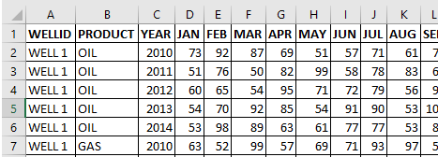
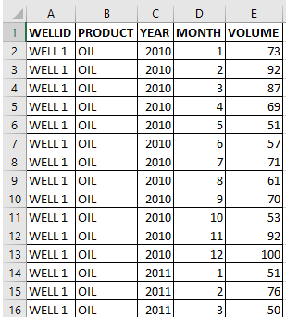
About The Data… (all on GitHub)
CSV files

Slide 10
Demo
demo
Map Reduce Review
Java, Python, AWK

Slide 11
Please Complete An Evaluation Form Your input is important!
You can access Evaluation Forms at:
http://TulsaTechFest.com
Fill them out!
You can win additional prizes!
Like a $50 Best Buy Gift Card!!
Winner drawn – Midnight, Sun Aug 7th!

Slide 12
Please help us!
Thank our Sponsors:

